Slide 1
Introduction to Networking and TCP/IP
Lecture 2

Slide 2
Outline
Networking Basics
Sockets
Remote Procedure Call

Slide 3
Networking
Layering
ISO OSI 7-layer model
Physical, data link, network, transport, session, presentation, application
TCP/IP model
Physical, Link, network, transport, application

Slide 4
TCP/IP Layering (cont.)
TCP/IP protocol stack
app
app
Encapsulation
HTTP/FTP/SMTP
Application Layer
TCP/UDP
Transport Layer
IP
Network Layer
ARP
Link Layer
Demultiplexing
Ethernet

Slide 5
Common Protocols in TCP/IP Protocol Stack
ARP: Address Resolution Protocol
IP: Internet Protocol (RFC 791)
UDP: User Datagram Protocol (RFC 768)
TCP: Transmission Control Protocol (RFC 793)

Slide 6
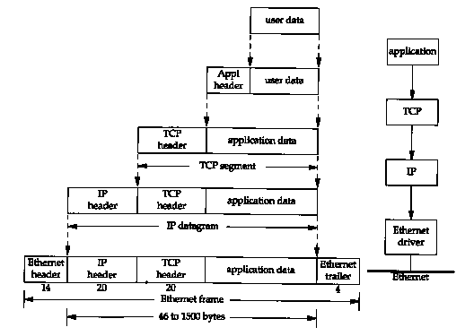
Encapsulation

Slide 7
Protocol Headers
Ethernet header
MAC (Ethernet) addresses
IP header
IP addresses, protocol
TCP/UDP header
Port numbers

Slide 8
ARP
X
X is here.
Ethernet (CSMA/CD)
Where is X?
A
B
IP address → Ethernet address

Slide 9
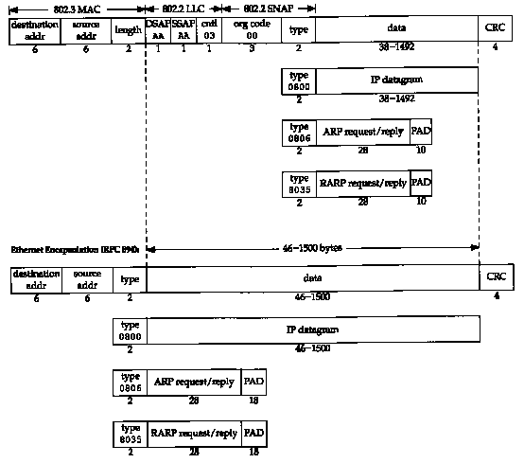
Ethernet Header

Slide 10
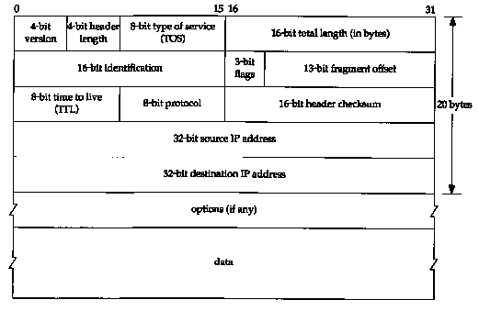
IP Header

Slide 11
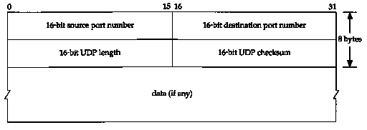
UDP Header

Slide 12
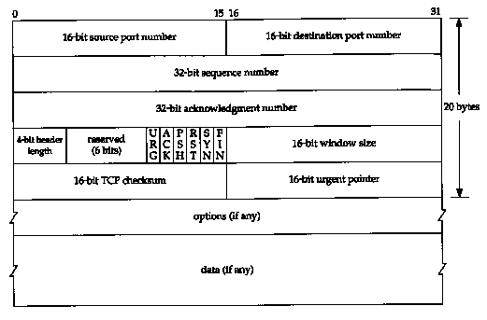
TCP Header

Slide 13
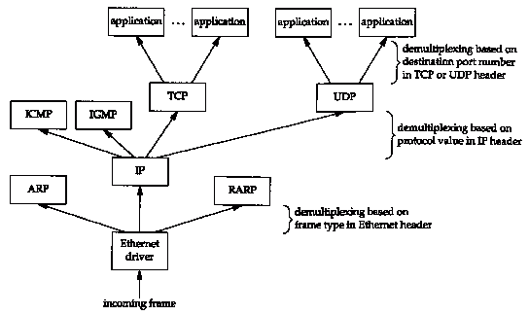
Demultiplexing

Slide 14
IP Addresses
IPv4 address
Dotted decimal: 140.112.8.130
Unicast, broadcast, and multicast
Private address space
10.0.0.0 - 10.255.255.255 (10/8 prefix)
172.16.0.0 - 172.31.255.255 (172.16/12 prefix)
192.168.0.0 - 192.168.255.255 (192.168/16 prefix)
Class A, B, C, D, E

Slide 15
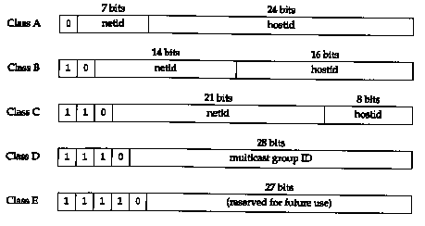
IP Addresses (cont.)

Slide 16
Port Numbers
Well-known ports: 1-1023
HTTP: 80
SMTP: 25
Telnet: 23
FTP: 21 (control), 20 (data)
Others
Gnutella: 6346, 6347
Client vs. server ports

Slide 17
Useful Tools
Packet sniffer or analyzer
Tcpdump
Ethereal
NetXRay
Packet generator
Socket programming
Packet capture libraries
Libpcap & WinPcap

Slide 18
Example Scenario: Web Browsing
http://www.ntu.edu.tw/
(140.112.8.130, 80)
25
Client
Server
80
23
61.2.3.4
www.ntu.edu.tw

Slide 19
Example Scenario: Web Browsing
DNS Server
www.ntu.edu.tw?
(140.112.8.130, 80)
25
Client
140.112.8.130
Server
80
23
61.2.3.4
www.ntu.edu.tw

Slide 20
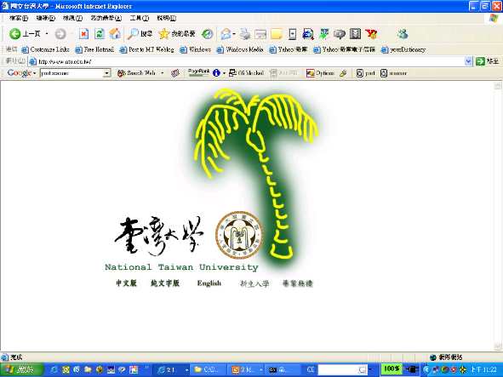
Example Scenario: Web Browsing
http://www.ntu.edu.tw/
(140.112.8.130, 80)
25
Client
Server
connect(140.112.8.130, 80)
7890
80
23
61.2.3.4
www.ntu.edu.tw

Slide 21
DNS Name Resolution
X
Ethernet (CSMA/CD)
X is 140.112.8.130.
A
DNS
Where is www.ntu.edu.tw?
hostname → IP address

Slide 22
ARP (Revisited)
140.112.8.130 00:C0:EB:00:8B:68
X
140.112.8.130 is 00:C0:EB:00:8B:68
Ethernet (CSMA/CD)
Where is 140.112.8.130?
A
B
IP address → Ethernet address

Slide 23
Sockets
ARP: Ethernet (hardware, MAC) address
IP: IP address
TCP/UDP: port number
Port vs. service
Sockets: {IP_{src}, port_{src}, IP_{dest}, port_{dest}}

Slide 24
Socket Connection
(61.2.3.4, 7890)
(140.112.8.130, 80)
25
Client
Server
connect(140.112.8.130, 80)
7890
80
23
61.2.3.4
www.ntu.edu.tw

Slide 25
Socket Programming
UNIX: BSD Socket API (in C)
socket(), bind(), listen(), accept(), connect(), send(), recv(), sendto(), recvfrom(), select(), …
Java Socket API
java.net.Socket
Perl, Python, …

Slide 26
Remote Procedure Call
RFC 1831 – RPC v2
RFC 1832 -- XDR: External Data Representation Standard
A machine-independent representation of data
Local vs. remote procedure calls

Slide 27
RPC
UDP/TCP transport
RPC/UDP: connectionless, fast
RPC/TCP: connection-oriented, slower
Portmap service (or portmapper)
Port 111
RFC 1833

Slide 28
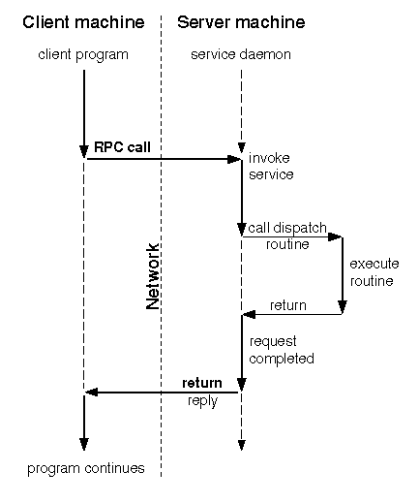
RPC

Slide 29
RPC Portmapping
25
Client
Server
connect(140.112.8.130, 111)
7890
111
Port P
connect(140.112.8.130, P)
P
61.2.3.4
140.112.8.130

Slide 30
RPC Programming
rpcgen
Applications: NFS (Network File System), …

Slide 31
Programming Exercises
Packet sending/receiving
FTP client/server
FTP (File Transfer Protocol): RFC 959
HTTP (Web) client/server
HTTP (HyperText Transfer Protocol) 1.1: RFC 2616
Mail client/server
SMTP (Simple Mail Transfer Protocol): RFC 2821
POP3 (Post Office Protocol Version 3): RFC 1939
IMAP4 (Internet Message Access Protocol – Verison 4rev1): RFC 3501
MIME, …
…

Slide 32
Further Readings
W. Richard Stallings, B. Fenner, A. M. Rudolf, UNIX Network Programming, Vol. 1: the Sockets Networking API, 3rd ed., Addison-Wesley, 2003.
E. R. Harold, Java Network Programming, 3rd ed., O’Reilly, 2004.
RFCs (Request for Comments), http://www.rfc-editor.org/

